Slide 1
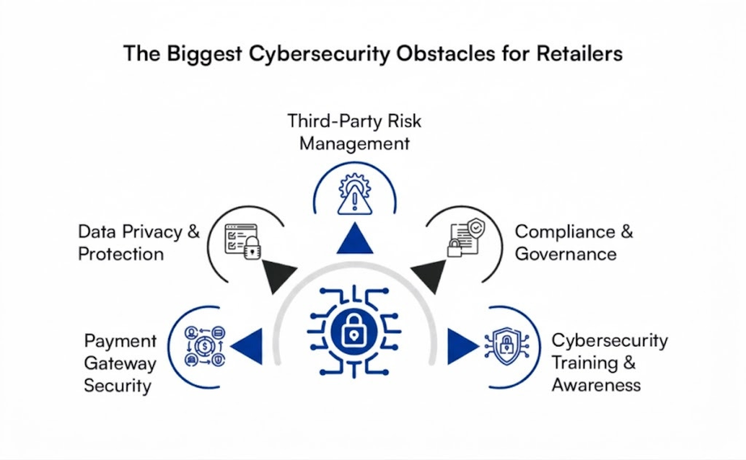
Cybersecurity Threats and Digital Fraud in E-commerce
Presenting Team
Abdullah Atif
ID: 241311051
Md. Saibur Rahman
ID: 241311053
Daniel Rozario
ID: 241311071
01

Slide 2
Introduction
Cybersecurity Threats & Digital Fraud in E-commerce
The E-commerce Landscape: Massive industry growth offset by highly profitable opportunities for cybercriminals.
2. Security as a Foundation: Not just an IT issue—critical to the business model.
3. Consumer Impact: Lack of perceived safety directly leads to cart abandonment.
02

Slide 3
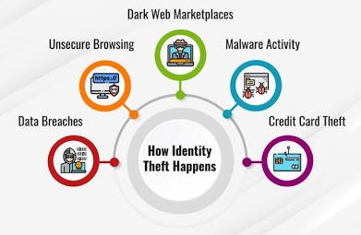
Primary Threat Vectors
Breaking Down E-commerce Fraud
Data Breaches: Compromising sensitive customer
databases.
Payment Fraud: Exploiting stolen financial data.
Identity Theft: Weaponizing customer trust and
accounts.
03

Slide 4
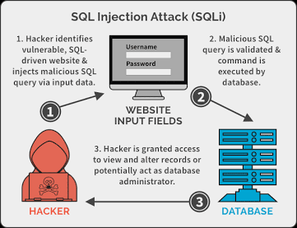
Data Breaches
Vulnerabilities at the Application Level
Definition: Unauthorized actors gaining access to
secure databases containing sensitive customer info.
Common Developer Pitfalls:
SQL Injection
Cross-Site Scripting (XSS)
Insecure API endpoints
04

Slide 5
Infrastructure Threats: PHP2Shell
When Perfect Code Isn't Enough
Recent Disclosure (Oct 2026): "PHP2Shell" (CVE-2026-109618 & CVE-2026-109619).
The Mechanism: Unauthenticated RCE in the core PHP engine.
The Exploit: Triggering "out-of-memory“ errors to corrupt server state.
The Danger: Bypasses app code; affects millions of sites (Magento, WooCommerce).
05

Slide 6
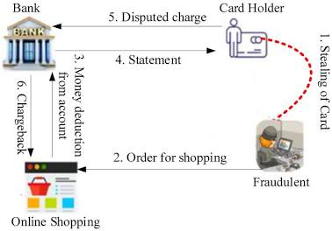
Payment Fraud
Weaponizing Stolen Data
Card-Not-Present (CNP) Fraud: Physical credit cards are not required for digital checkout.
Automated Attacks: Criminals deploy bots to test bulk stolen credit card numbers.
Merchant Impact: E-commerce businesses bear the brunt through severe chargeback fees and lost physical inventory.
06

Slide 7
Identity Theft & Account Takeovers
Exploiting Trusted Users
Account Takeover
The Inside Threat
Evasion
Credential stuffing via password reuse.
Draining loyalty points and saved payment methods.
Bypasses fraud filters using trusted accounts.
07

Slide 8
Architectural Defenses
Securing the Foundation
Encryption: Strict hashing of all sensitive backend data.
Tokenization: Never store raw credit card numbers. Partner with compliant gateways (PayPal).
Infrastructure Maintenance: Aggressively update runtime environments to patch underlying engine flaws (like PHP2Shell).
08

Slide 9
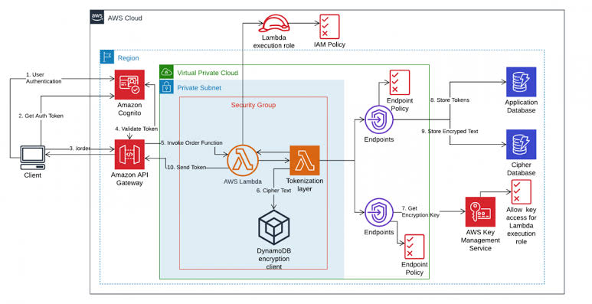
Architectural Defenses
09

Slide 10
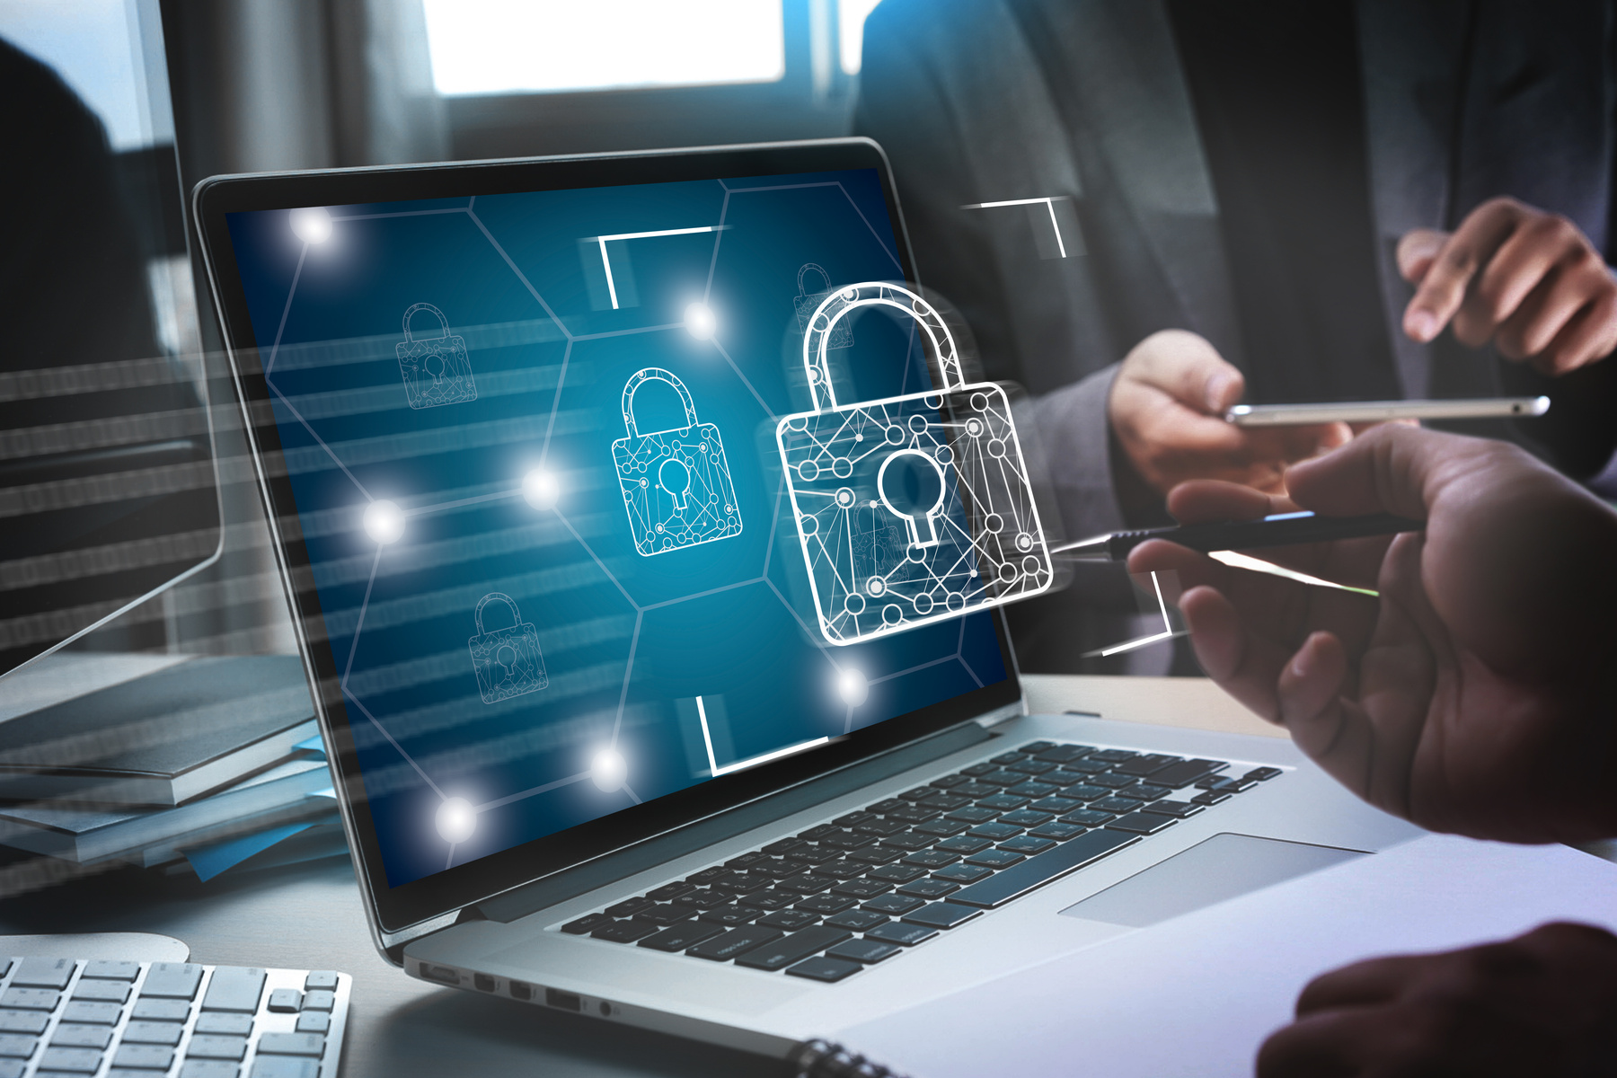
Active Defenses & Building Trust
Balancing Security and User Experience
Risk-Based Authentication
Using MFA and behavioral analytics for anomalies.
Transparency
Displaying security badges & privacy policies.
Proactive Alerts
Notifying users of suspicious activity instantly.
Goal
Protect customers without creating checkout friction.
10

Slide 11

Thank You!
11

